Slide 1
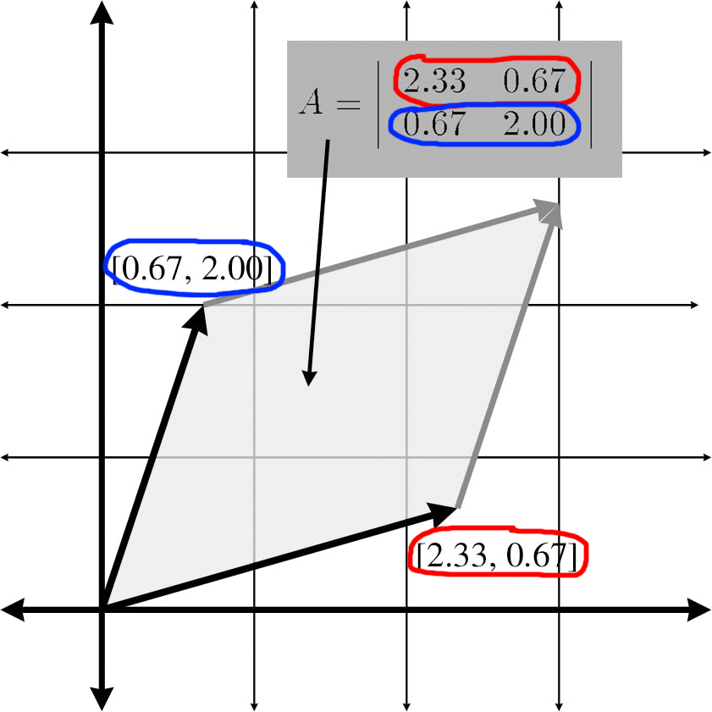
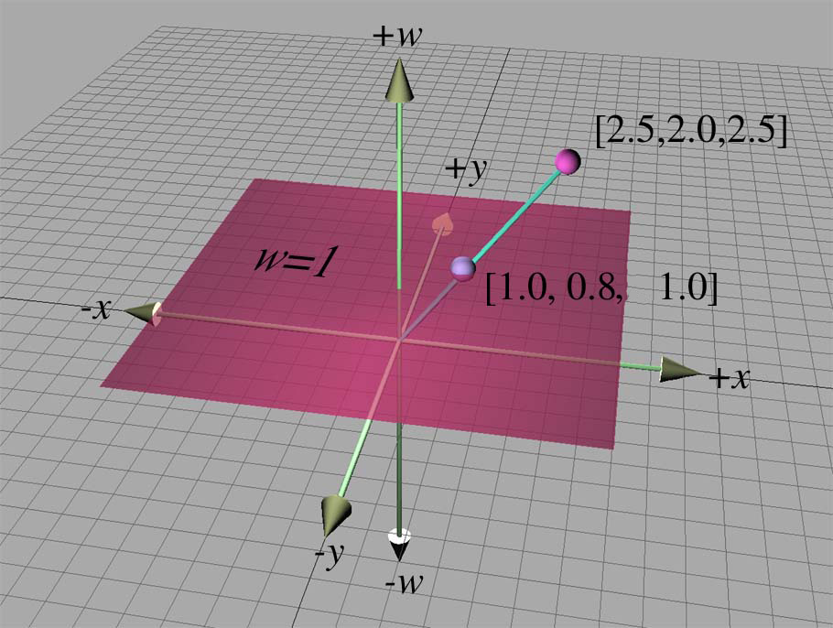
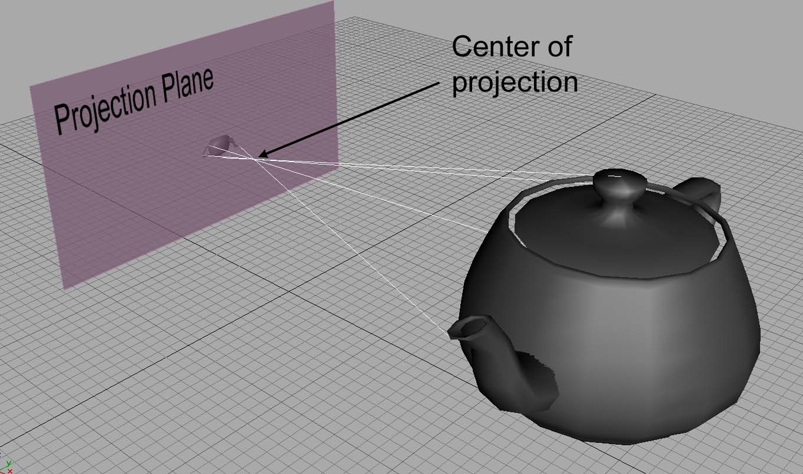
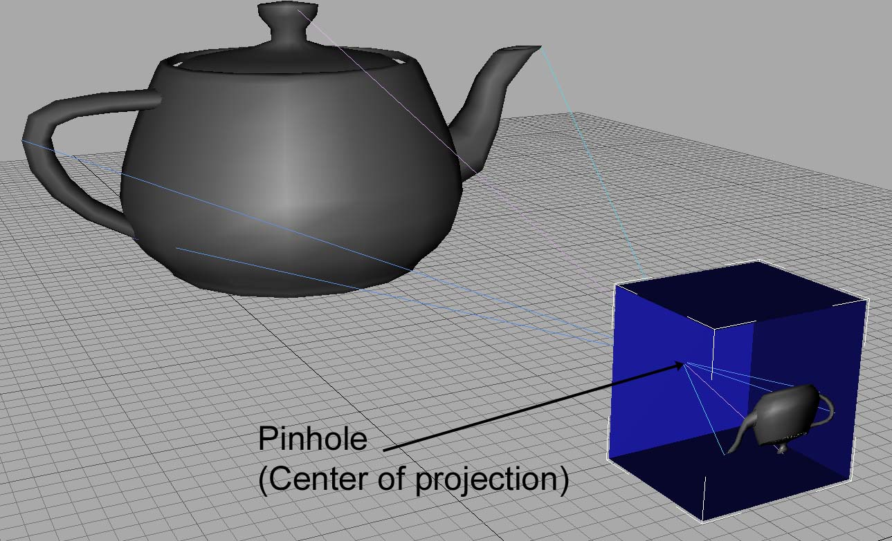
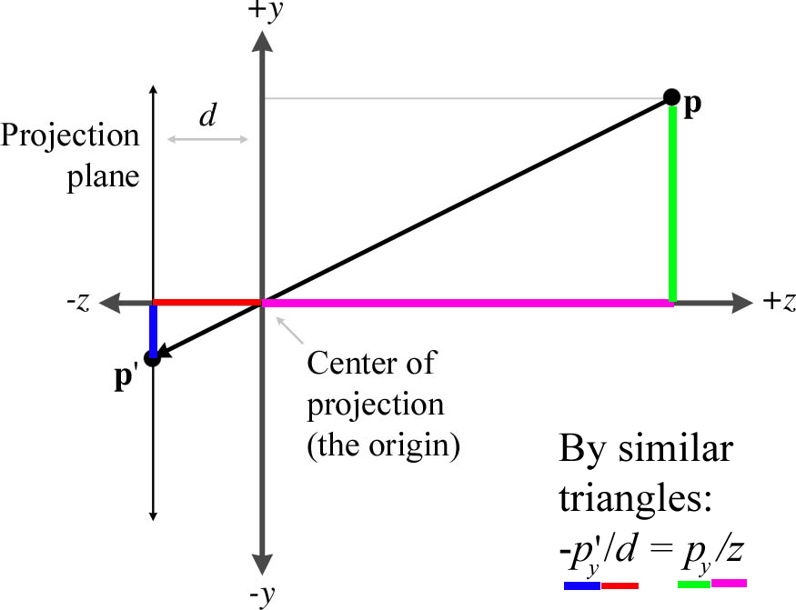
Chapter 6 More on Matrices
Fletcher Dunn
Valve Software
Ian Parberry
University of North Texas
3D Math Primer for Graphics & Game Development

Slide 2
What You’ll See in This Chapter
This chapter completes our coverage of matrices by discussing a few more interesting and useful matrix operations. It is divided into five sections.
Section 6.1 covers the determinant of a matrix.
Section 6.2 covers the inverse of a matrix.
Section 6.3 discusses orthogonal matrices.
Section 6.4 introduces homogeneous vectors and 4×4 matrices, and shows how they can be used to perform affine transformations in 3D.
Section 6.5 discusses perspective projection and shows how to do it with a 4×4 matrix.

Slide 3

Word Cloud

Slide 4
Section 6.1: Determinant of a Matrix

Slide 5
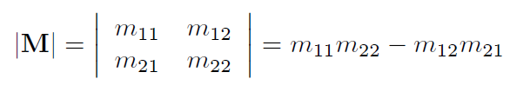
Determinant
Determinant is defined for square matrices.
Denoted |M| or det M.
Determinant of a 2x2 matrix is

Slide 6
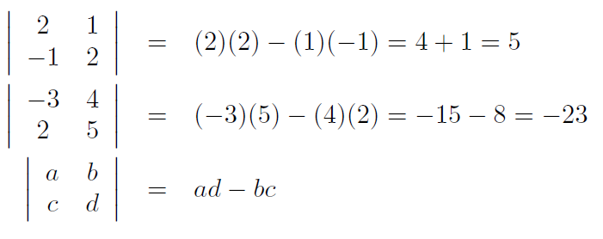
2 x 2 Example

Slide 7
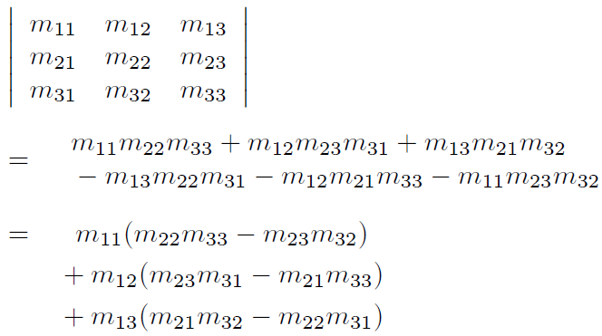
3 x 3 Determinant

Slide 8
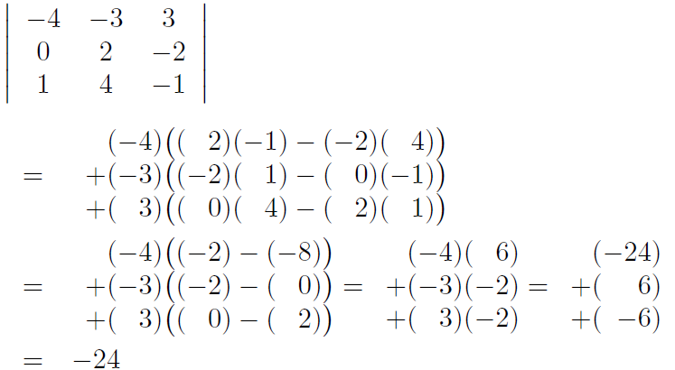
3 x 3 Example

Slide 9
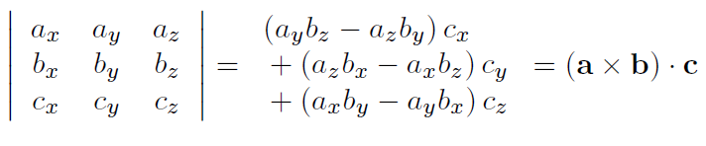
Triple Product
If we interpret the rows of a 3x3 matrix as three vectors, then the determinant of the matrix is equivalent to the so-called triple product of the three vectors:

Slide 10
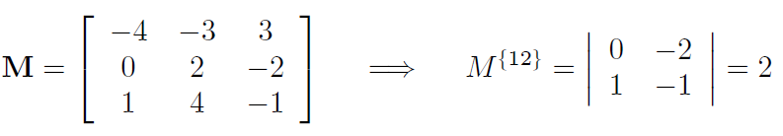
Minors
Let M be an r x c matrix.
Consider the matrix obtained by deleting row i and column j from M.
This matrix will obviously be r-1 x c-1.
The determinant of this submatrix, denoted M^{{ij}} is known as a minor of M.
For example, the minor M^{{12}} is the determinant of the 2 x 2 matrix that is the result of deleting the 1st row and 2nd column from M:

Slide 11

Cofactors
The cofactor of a square matrix M at a given row and column is the same as the corresponding minor, only every alternating minor is negated.
We will use the notation C^{{12}} to denote the cofactor of M in row i, column j.
Use (-1)^{(i+j)} term to negate alternating minors.

Slide 12
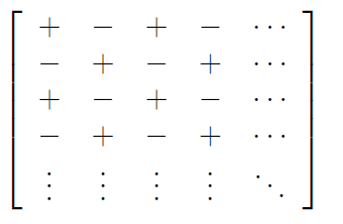
Negating Alternating Minors
The (-1)^{(i+j)} term negates alternating minors in this pattern:

Slide 13
n x n Determinant
The definition we will now consider expresses a determinant in terms of its cofactors.
This definition is recursive, since cofactors are themselves signed determinants.
First, we arbitrarily select a row or column from the matrix.
Now, for each element in the row or column, we multiply this element by the corresponding cofactor.
Summing these products yields the determinant of the matrix.

Slide 14
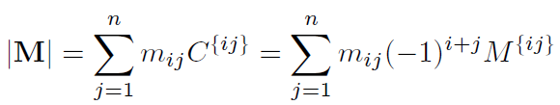
n x n Determinant
For example, arbitrarily selecting row i, the determinant can be computed by:

Slide 15
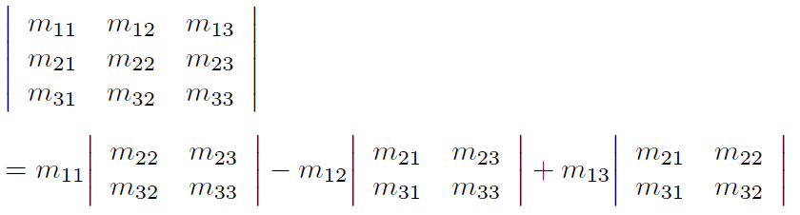
3 x 3 Determinant

Slide 16
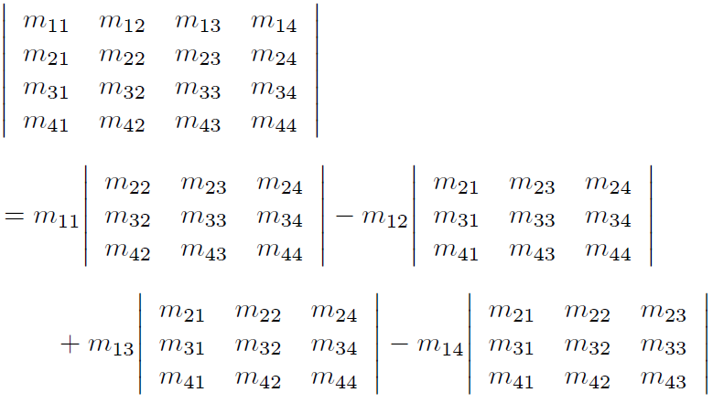
4 x 4 Determinant

Slide 17
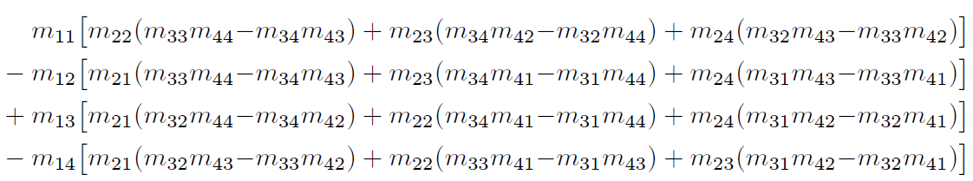
Expanding Cofactors This Equals

Slide 18
Important Determinant Facts
The identity matrix has determinant 1:|I| = 1.
The determinant of a matrix product is equal to the product of the determinants:
|AB| = |A||B|.
This extends to multiple matrices:
|M₁M₂…M_{n-1} M_{n}| = |M₁||M₂|… |M_{n-1}||M_{n}|.
The determinant of the transpose of a matrix is equal to the original.
|M^{T}| = |M|.

Slide 19
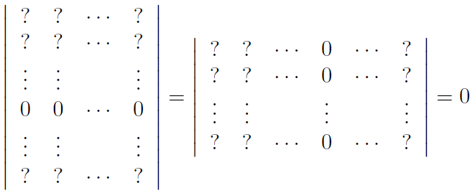
Zero Row or Column
If any row of column in a matrix contains all zeros, then the determinant of that matrix is zero.

Slide 20
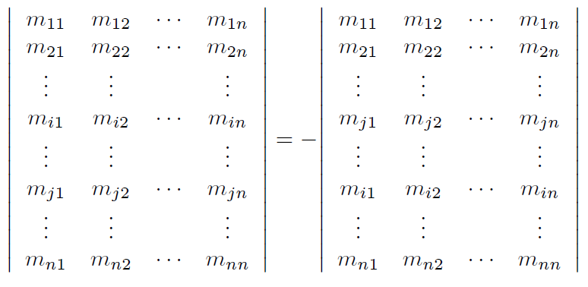
Exchanging Rows or Columns
Exchanging any pair of rows or columns negates the determinant.

Slide 21
Adding a Multiple of a Row or Column
Adding any multiple of a row (or column) to another row (or column) does not change the value of the determinant.
This explains why shear matrices from Chapter 5 have a determinant of 1.

Slide 22
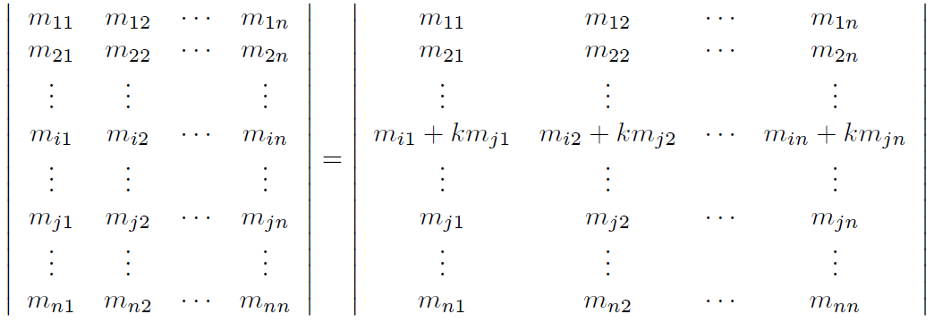

Slide 23
Geometric Interpretation
In 2D, the determinant is equal to the signed area of the parallelogram or skew box that has the basis vectors as two sides.
By signed area, we mean that the area is negative if the skew box is flipped relative to its original orientation.

Slide 24
2 x 2 Determinant as Area

Slide 25
3 x 3 Determinant as Volume
In 3D, the determinant is the volume of the parallelepiped that has the transformed basis vectors as three edges.
It will be negative if the object is reflected (turned inside out) as a result of the transformation.

Slide 26
Uses of the Determinant
The determinant is related to the change in size that results from transforming by the matrix.
The absolute value of the determinant is related to the change in area (in 2D) or volume (in 3D) that will occur as a result of transforming an object by the matrix.
The determinant of the matrix can also be used to help classify the type of transformation represented by a matrix.
If the determinant of a matrix is zero, then the matrix contains a projection.
If the determinant of a matrix is negative, then the matrix contains a reflection.

Slide 27
Section 6.2: Inverse of a Matrix

Slide 28
Inverse of a Matrix
The inverse of a square matrix M, denoted M⁻¹ is the matrix such that when we multiply by M⁻¹, the result is the identity matrix.
M M⁻¹ = M⁻¹M = I.
Not all matrices have an inverse.
An obvious example is a matrix with a row or column of zeros: no matter what you multiply this matrix by, you will end up with the zero matrix.
If a matrix has an inverse, it is said to be invertible or non-singular. A matrix that does not have an inverse is said to be non-invertible or singular.

Slide 29
Invertibility and Linear Independence
For any invertible matrix M, the vector equality vM = 0 is true only when v = 0.
Furthermore, the rows of an invertible matrix are linearly independent, as are the columns.
The rows and columns of a singular matrix are linearly dependent.

Slide 30
Determinant and Invertibility
The determinant of a singular matrix is zero and the determinant of a non-singular matrix is non-zero.
Checking the magnitude of the determinant is the most commonly used test for invertibility, because it's the easiest and quickest.

Slide 31
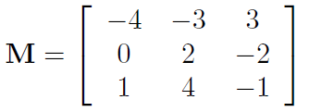
The Classical Adjoint
Our method for computing the inverse of a matrix is based on the classical adjoint.
The classical adjoint of a matrix M, denoted adj M, is defined to be the transpose of the matrix of cofactors of M.
For example, let:

Slide 32
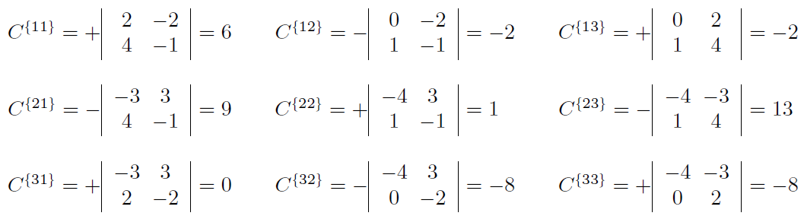
Computing the Cofactors
Compute the cofactors of M:

Slide 33
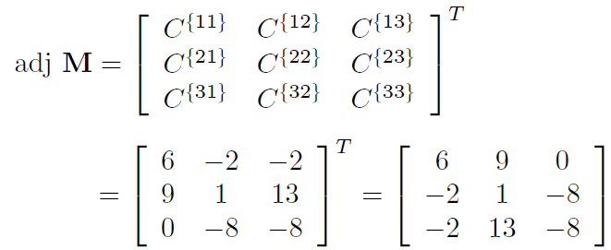
Classical Adjoint of M
The classical adjoint of M is the transpose of the matrix of cofactors:

Slide 34
Back to the Inverse
The inverse of a matrix is its classical adjoint divided by its determinant:
M⁻¹ = adj M / |M|.
If the determinant is zero, the division is undefined, which jives with our earlier statement that matrices with a zero determinant are non-invertible.

Slide 35
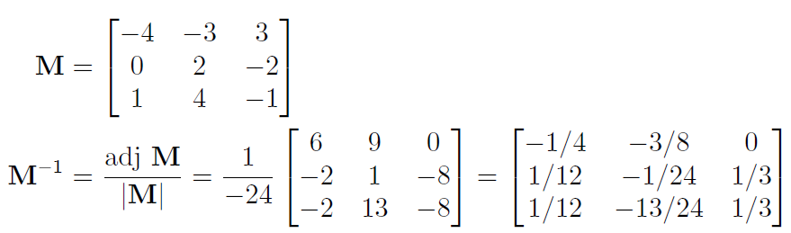
Example of Matrix Inverse
If:

Slide 36
Gaussian Elimination
There are other techniques that can be used to compute the inverse of a matrix, such as Gaussian elimination.
Many linear algebra textbooks incorrectly assert that such techniques are better suited for implementation on a computer because they require fewer arithmetic operations.
This is true for large matrices, or for matrices with a structure that can be exploited.
However, for arbitrary matrices of smaller order like the 2 x 2, 3 x 3, and 4 x 4 used most often in geometric applications, the classical adjoint method is faster.
The reason is that the classical adjoint method provides for a branchless implementation, meaning there are no if statements or loops that cannot be unrolled statically.
This is a big win on today's superscalar architectures and vector processors.

Slide 37
Facts About Matrix Inverse
The inverse of the inverse of a matrix is the original matrix. If M is nonsingular, (M⁻¹)⁻¹ = M.
The identity matrix is its own inverse: I⁻¹ = I.
Note that there are other matrices that are their own inverse, such as any reflection matrix, or a matrix that rotates 180° about any axis.
The inverse of the transpose of a matrix is the transpose of the inverse: (M^{T})⁻¹ = (M⁻¹)^{T}

Slide 38
More Facts About Matrix Inverse
The inverse of a product is equal to the product of the inverses in reverse order.
(AB)⁻¹ = B⁻¹A⁻¹
This extends to more than two matrices:
(M₁M₂…M_{n-1} M_{n})⁻¹ = M_{n}⁻¹M_{n-1}⁻¹…. M₂⁻¹M₁⁻¹
The determinant of the inverse is the inverse of the determinant: |M⁻¹| = 1/|M|.

Slide 39
Geometric Interpretation of Inverse
The inverse of a matrix is useful geometrically because it allows us to compute the reverse or opposite of a transformation – a transformation that undoes another transformation if they are performed in sequence.
So, if we take a vector v, transform it by a matrix M, and then transform it by the inverse M⁻¹ of M, then we will get v back.
We can easily verify this algebraically:
(vM)M⁻¹ = v(MM⁻¹) = vI = v

Slide 40
Section 6.3: Orthogonal Matrices

Slide 41
Orthogonal Matrices
A square matrix M is orthogonal if and only if the product of the matrix and its transpose is the identity matrix: MM^{T} = I.
If a matrix is orthogonal, its transpose and the inverse are equal: M^{T} = M⁻¹.
If we know that our matrix is orthogonal, we can essentially avoid computing the inverse, which is a relatively costly computation.
For example, rotation and reflection matrices are orthogonal.

Slide 42
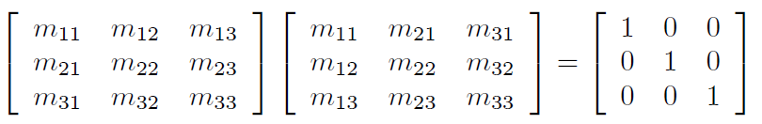
Testing Orthogonality
Let M be a 3 x 3 matrix. Let's see exactly what it means when MM^{T} = I.

Slide 43
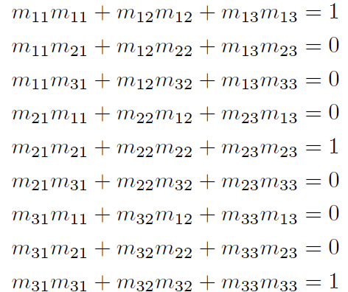
9 Equations
This gives us 9 equations, all of which must be true in order for M to be orthogonal:

Slide 44
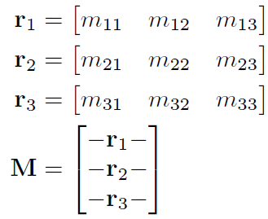
Consider the Rows
Let the vectors r₁, r₂, r₃ stand for the rows of M:

Slide 45
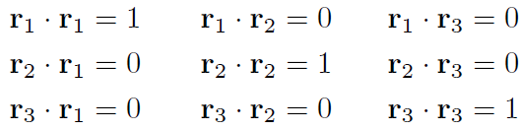
9 Equations Using Dot Product
Now we can re-write the 9 equations more compactly:

Slide 46
Two Observations
First, the dot product of a vector with itself is 1 if and only if the vector is a unit vector.
Therefore, the equations with a 1 on the right hand side of the equals sign will only be true when r₁, r₂, and r₃ are unit vectors.
Second, the dot product of two vectors is 0 if and only if they are perpendicular.
Therefore, the other six equations (with 0 on the right hand side of the equals sign) are true when r₁, r₂, and r₃ are mutually perpendicular.

Slide 47
Conclusion
So, for a matrix to be orthogonal, the following must be true:
Each row of the matrix must be a unit vector.
The rows of the matrix must be mutually perpendicular.
Similar statements can be made regarding the columns of the matrix, since if M is orthogonal, then M^{T} must be orthogonal.

Slide 48
Orthonormal Bases Revisited
Notice that these criteria are precisely those that we said in Chapter 3 were satisfied by an orthonormal set of basis vectors.
There we also noted that an orthonormal basis was particularly useful because we could perform the “opposite” coordinate transform from the one that is always available, using the dot product.
When we say that the transpose of an orthogonal matrix is its inverse, we are just restating this fact in the formal language of linear algebra.

Slide 49
9 is Actually 6
Also notice that 3 of the orthogonality equations are duplicates (since dot product is commutative), and between these 9 equations, we actually have 6 constraints, leaving 3 degrees of freedom.
This is interesting, since 3 is the number of degrees of freedom inherent in a rotation matrix.
But again note that rotation matrices cannot compute a reflection, so there is slightly more freedom in the set of orthogonal matrices than in the set of orientations in 3D.

Slide 50
Caveats
When computing a matrix inverse we will usually only take advantage of orthogonality if we know a priori that a matrix is orthogonal.
If we don't know in advance, it's probably a waste of time checking.
Finally, even matrices which are orthogonal in the abstract may not be exactly orthogonal when represented in floating point, and so we must use tolerances, which have to be tuned.

Slide 51
A Note on Terminology
In linear algebra, we described a set of basis vectors as orthogonal if they are mutually perpendicular.
It is not required that they have unit length. If they do have unit length, they are an orthonormal basis.
Thus the rows and columns of an orthogonal matrix are orthonormal basis vectors.
However, constructing a matrix from a set of orthogonal basis vectors does not necessarily result in an orthogonal matrix (unless the basis vectors are also orthonormal).

Slide 52
Scary Monsters (Matrix Creep)
Recall that that rotation matrices (and products of them) are orthogonal.
Recall that the rows of an orthogonal matrix form an orthonormal basis.
Or at least, that’s the way we’d like them to be.
But the world is not perfect. Floating point numbers are subject to numerical instability.
Aka “matrix creep” (apologies to David Bowie)
We need to orthogonalize the matrix, resulting in a matrix that has mutually perpendicular unit vector axes and is (hopefully) as close to the original matrix as possible.

Slide 53
Gramm-Schmidt Orthogonalization
Here’s how to control matrix creep.
Go through the rows of the matrix in order.
For each, subtract off the component that is parallel to the other rows.
More details: let r₁, r₂, r₃ be the rows of a 3 x 3 matrix M.
Remember, you can also think of these as the x-, y-, and z-axes of a coordinate space.
Then an orthogonal set of row vectors, r₁′, r₂′, r₃′ can be computed as follows:

Slide 54
Steps 1 and 2
Step 1: Normalize r₁ to get a new vector r₁′ (meaning make its magnitude 1)
Step 2: Replace r₂ by
r₂′= r₂ – (r₁′.r₂) r₁′
r₂′ is now perpendicular to r₁′ because
r₁′.r₂′ = r₁′.(r₂ – (r₁′.r₂) r₁′)
= r₁′.r₂ – (r₁′.r₂)(r₁′.r₁′)
= r₁′.r₂ – r₁′.r₂
= 0

Slide 55
Steps 3, 4, and 5
Step 3: Normalize r₂′
Step 4: Replace r₃ by
r₃′= r₃ – (r₁′.r₃) r₁′ – (r₂′.r₃) r₂′
Step 5: Normalize r₃′

Slide 56
Checking r₃′ and r₁′
r₃′ is now perpendicular to r₁′ because
r₁′.r₃′ = r₁′.(r₃ – (r₁′.r₃) r₁′ – (r₂′.r₃) r₂′)
= r₁′.r₃ – (r₁′.r₃) (r₁′.r₁′) – (r₂′.r₃) (r₁′.r₂′)
= r₁′.r₃ – r₁′.r₃ – 0
= 0

Slide 57
Checking r₃′ and r₂′
r₃′ is now perpendicular to r₂′ because
r₂′.r₃′ = r₂′.(r₃ – (r₁′.r₃) r₁′ – (r₂′.r₃) r₂′)
= r₂′.r₃ – (r₁′.r₃) (r₂′.r₁′) – (r₂′.r₃) (r₂′.r₂′)
= r₂′.r₃ – 0– r₂′.r₃
= 0

Slide 58
Bias
This is biased towards r₁, meaning that r₁ doesn’t change but the other basis vectors do change.
Option: instead of subtracting off the whole amount, subtract off a fraction of the original axis.
Let k be a fraction – say 1/4

Slide 59
Gramm-Schmidt in Practice
Step 1: normalize r₁, r₂, r₃
Step 2: repeat a dozen or so times:
r₁′ = r₁ – k (r₁.r₂) r₂ – k (r₁.r₃) r₃
r₂′ = r₂ – k (r₁.r₂) r₁ – k (r₂.r₃) r₃
r₃′ = r₃ – k (r₁.r₃) r₁ – k (r₂.r₃) r₂
Step 3: Do a vanilla Gramm-Schmidt to catch any remaining “abnormality”

Slide 60
Section 6.3: 4×4 Homogenous Matrices

Slide 61
Homogenous Coordinates
Extend 3D into 4D.
The 4th dimension is not “time”.
The 4th dimension is really just a kluge to help the math work out (later in this lecture).
The 4th dimension is called w.

Slide 62
Extending 1D into Homogenous Space
Start with 1D, its easier to visualize than 3D.
Homogenous 1D coords are of the form (x, w).
Imagine the vanilla 1D line lying at w = 1.
So the 1D point x has homogenous coords (x, 1).
Given a homogenous point (x, w), the corresponding 1D point is its projection onto the line w = 1 along a line to the origin, which turns out to be (x/w, 1).

Slide 63
Projecting Onto 1D Space
Each point x in 1D space corresponds to an infinite number of points in homogenous space, those on the line from the origin through the point (x, 1).
The homogenous points on this line project onto its intersection with the line w = 1.

Slide 64
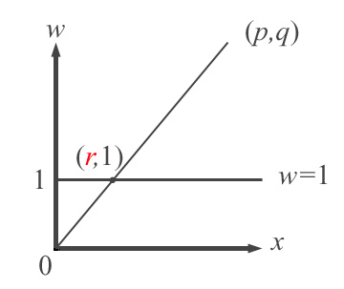
What are the 2D Coords of Homogenous Point (p,q)?

Slide 65
Simultaneous Equations
Equation of line is w = ax + b
(p, q) and (0, 0) are on the line.
Therefore:
q = ap + b
0 = a0 + b,
That is, b = 0 and a = q/p.

Slide 66
What is r?
So equation of line is w = qx/p.
Therefore, when w = 1, x = p/q.
This means that r = p/q.
So the homogenous point (p, q) projects onto the 1D point (p/q, 1).
That is, the 1D equivalent of the homogenous point (p, q) is p/q.

Slide 67
Extending 2D into Homogenous Space
2D next, it’s still easier to visualize than 3D.
Homogenous 2D coordinates are of the form (x, y, w).
Imagine the vanilla 2D plane lying at w = 1.
So the 2D point (x, y) has homogenous coordinates (x, y, 1).

Slide 68
Projecting Onto 2D Space
Each point (x, y) in 2D space corresponds to an infinite number of points in homogenous space.
Those on the line from the origin thru (x, y, 1).
The homogenous points on this line project onto its intersection with the plane w = 1.

Slide 70
2D Homogenous Coordinates
Just like before (argument omitted), the homogenous point (x, y, w) corresponds to the 2D point (x/w, y/w, 1).
That is, the 2D equivalent of the homogenous point (p, q, r) is (p/r, q/r).

Slide 71
3D Homogenous Coordinates
This extends to 3D in the obvious way.
The homogenous point (x, y, z, w) corresponds to the 3D point (x/w, y/w, z/w, 1).
That is, the 3D equivalent of the homogenous point (p, q, r, s) is (p/s, q/s, r/s).

Slide 72
Point at Infinity
w can be any value except 0 (divide by zero error).
The point (x,y,z,0) can be viewed as a “point at infinity”

Slide 73
Why Use Homogenous Space?
It will let us handle translation with a matrix transformation.
Embed 3D space into homogenous space by basically ignoring the w component.
Vector (x, y, z) gets replaced by (x, y, z, 1).
Does that “1” at the end sound familiar?

Slide 74
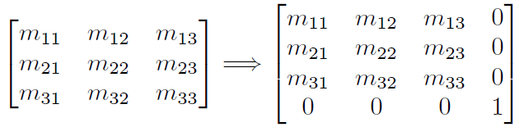
Homogenous Matrices
Embed 3D transformation matrix into 4D matrix by using the identity in the w row and column.

Slide 75
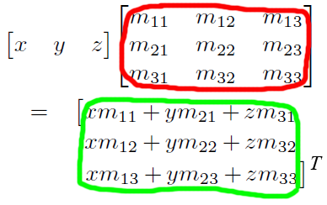
3D Matrix Multiplication

Slide 76
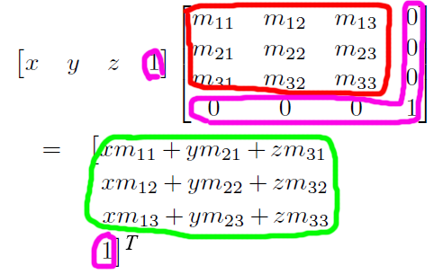
4D Matrix Multiplication

Slide 77
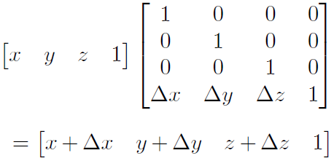
Translation Matrices
Kluge 3D translation matrix by shearing 4D space.

Slide 78
Translation vs. Orientation
Just like in 3D, compose 4D operations by multiplying the corresponding matrices.
The translation and orientation parts of a composite matrix are independent.
For example, let R be a rotation matrix and T be a translation matrix.
What does M = RT look like?

Slide 79
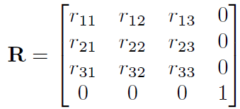
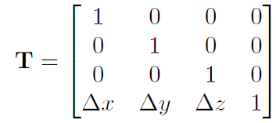

Slide 80
Rotate then Translate
Then we could rotate and then translate a point v to a new point v′ using v′ = vRT.
We are rotating first and then translating.
The order of transformations is important, and since we use row vectors, the order of transformations coincides with the order that the matrices are multiplied, from left to right.

Slide 81
M = RT
Just as with 3 x 3 matrices, we can concatenate the two matrices into a single transformation matrix, which we'll call M.
Let M = RT, so
v′ = vRT = v(RT) = vM

Slide 82
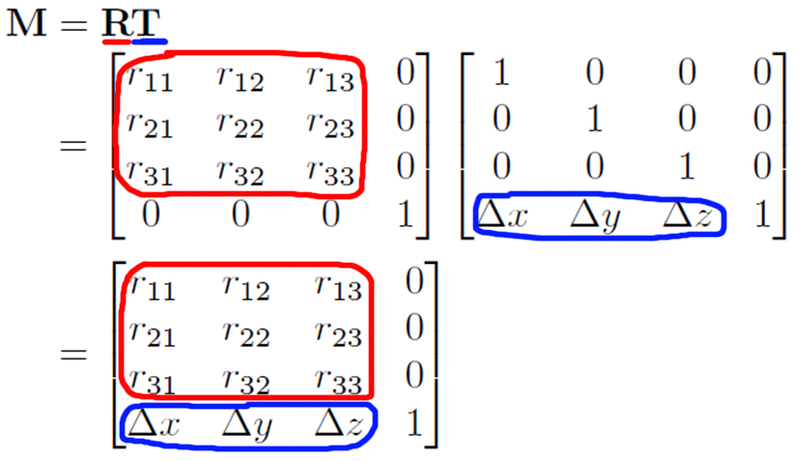

Slide 83

In Reverse
Applying this information in reverse, we can take a 4 x 4 matrix M and separate it into a linear transformation portion, and a translation portion.
We can express this succinctly by letting the translation vector t = [Δx, Δy, Δz].

Slide 84
Points at Infinity Again
Points at infinity are actually useful.
They orient just like points with w ≠ 0: multiply by the orientation matrix.
But they don’t translate: translation matrices have no effect on them.

Slide 85
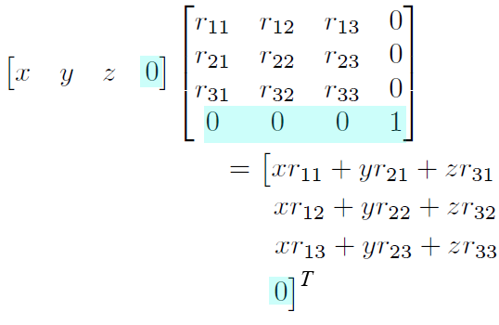
Matrix Without Translation

Slide 86
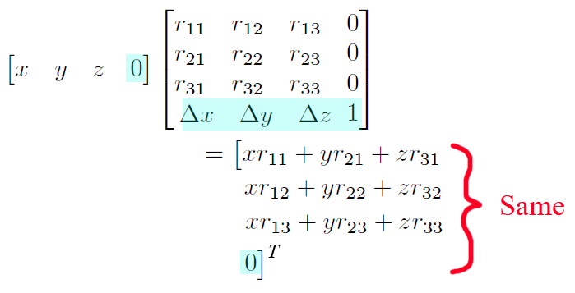
Matrix With Translation

Slide 87
So What?
The translation part of 4D homogenous transformation matrices has no effect on points at infinity.
Use points at infinity for things that don’t need translating (eg. Surface normals).
Use regular points (with w = 1) for things that do need translating (eg. Points that make up game objects).

Slide 88
4x3 Matrices
The last column of 4D homogenous transformation matrices is always [0, 0, 0, 1]^{T}.
Technically it always needs to be there for the algebra to work out.
But we know what it’s going to do, so there’s no reason to implement it in code.

Slide 89
General Affine Transformations
Armed with 4 x 4 transform matrices, we can now create more general affine transformations that contain translation. For example:
Rotation about an axis that does not pass through the origin
Scale about a plane that does not pass through the origin
Reflection about a plane that does not pass through the origin
Orthographic projection onto a plane that does not pass through the origin

Slide 90
General Affine Transformations
The basic idea is to translate the center of the transformation to the origin, perform the linear transformation using the techniques developed in Chapter 5, and then transform the center back to its original location.
We will start with a translation matrix T that translates the point p to the origin, and a linear transform matrix R from Chapter 5 that performs the linear transformation.
The final transformation matrix A will be the equal to the matrix product TRT⁻¹.
T⁻¹ is of course the translation matrix with the opposite translation amount as T.

Slide 91
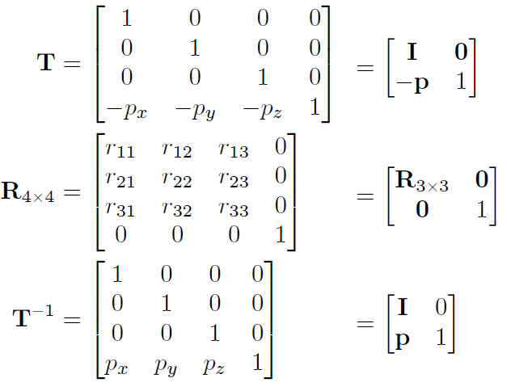


Slide 92
Observation
Thus, the extra translation in an affine transformation only changes the last row of the 4 x 4 matrix.
The upper 3 x 3 portion, which contains the linear transformation, is not affected.
Our use of homogenous coordinates so far has really been nothing more than a mathematical kludge to allow us to include translation in our transformations.

Slide 93
Section 6.4: 4×4 Matrices and Perspective Projection

Slide 94
Projections
We’ve only used w = 1 and w = 0 so far.
There’s a use for the other values of w too.
We’ve seen how to do orthographic projection before.
Now we’ll see how to do perspective projection too.

Slide 95
Orthographic Projection
Orthographic projection has parallel projectors.
The projected image is the same size no matter how far the object is from the projection plane.
We want objects to get smaller with distance.
This is known as perspective foreshortening.

Slide 96
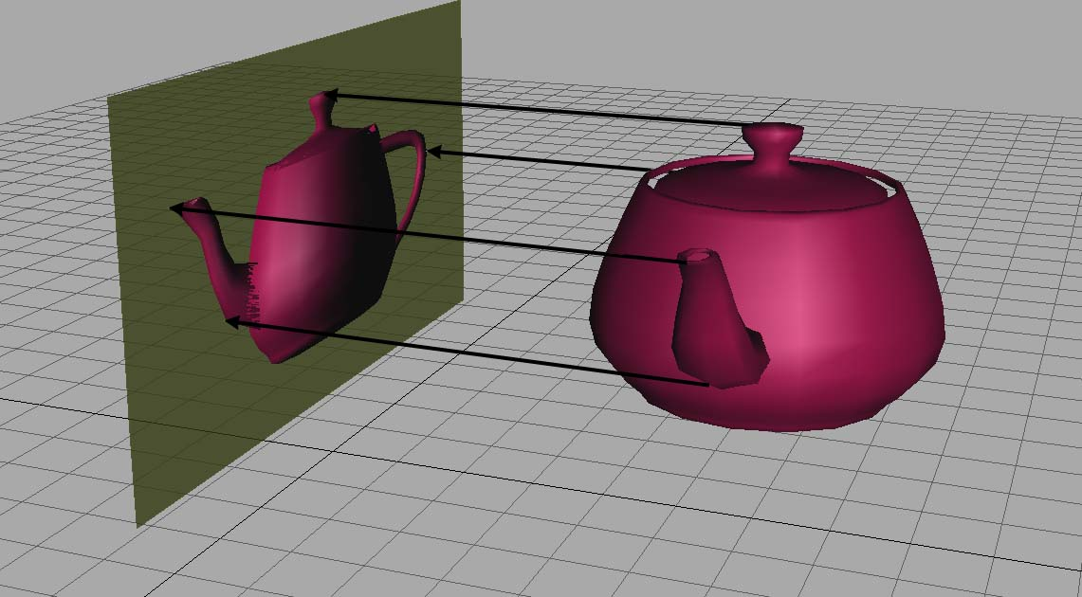
Orthographic Projection

Slide 97
Perspective Projection

Slide 98
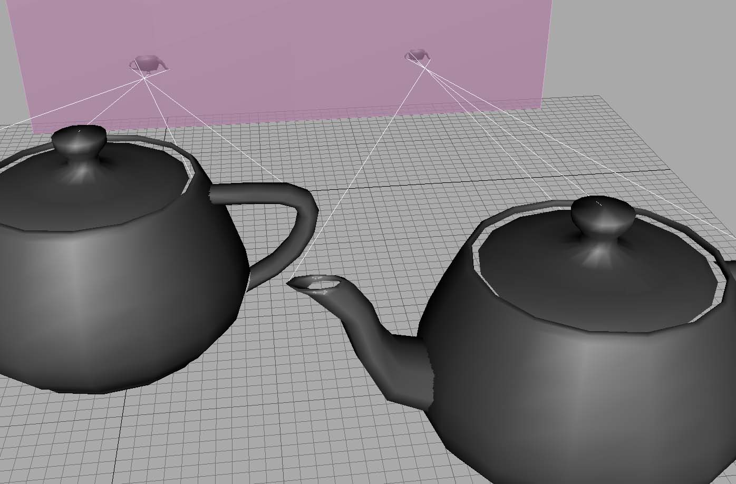
Perspective Foreshortening

Slide 99
The Pinhole Camera
The math is based on a pinhole camera.
Take a closed box that’s very dark inside.
Make a pinhole.
If you point the pinhole at something bright, an image of the object will be projected onto the back of the box.
That’s kind of how the human eye works too.

Slide 101
Projection Geometry
Let’s project on a plane parallel to the x-y plane.
Choose a distance d from the pinhole to the projection plane, called the focal distance.
The pinhole is called the focal point.
Put the focal point at the origin and the projection plane at z = -d.
(Remember the concept of camera space?)

Slide 102
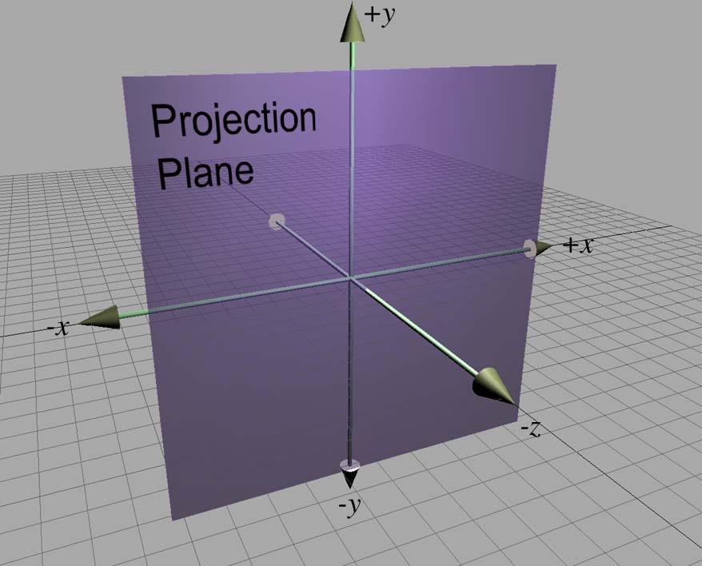

Slide 103
Do the Math
View it from the side.
Consider where a point p gets projected onto the plane – at a point p′
Start with the y coordinate for now.

Slide 105


Finding p′
From the previous slide, by similar triangles:
Same for the x-axis:

Slide 106
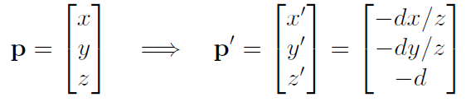
Result
All projected points have a z value of –d.
Therefore p is projected onto p′ like this:

Slide 107
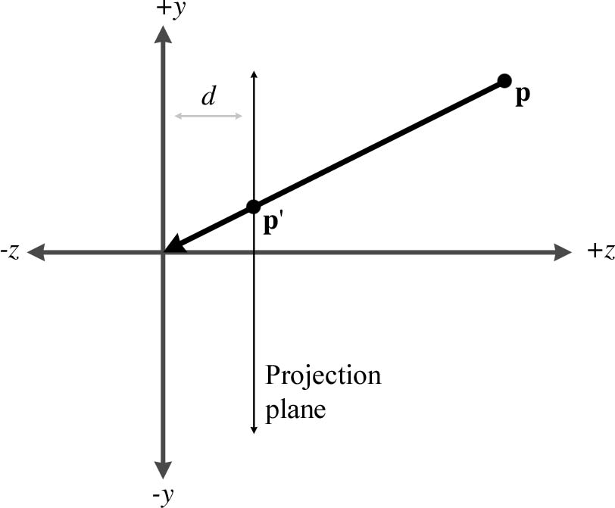
In Practice
In practice we move the projection plane in front of the focal point.

Slide 108
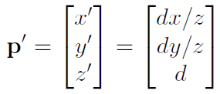
Accentuate the Positive
Doing so removes the annoying minus signs. This:
Becomes this:

Slide 109
Projection Using 4D Matrix
We can actually do this with a 4D homogenous matrix.
First manipulate p′ to have a common denominator:
p′ = [ dx/z dy/z d ]
= [ dx/z dy/z dz/z ]
= (d/z) [ x y z ]

Slide 110
Entering the 4th Dimension
To multiply by d/z, divide by z/d.
Instead of dividing by z/d, make that our w coordinate:
[ x y z z/d ]
We need a 4x4 matrix that transforms an “ordinary” point [ x y z 1 ] into this.

Slide 111
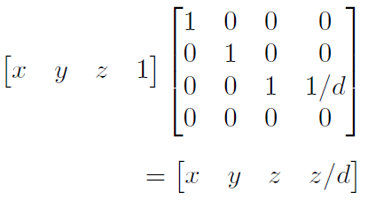
The Projection Matrix

Slide 112
Notes
Multiplication by this matrix doesn't actually perform the perspective transform, it just computes the proper denominator into w. The perspective division actually occurs when we convert from 4D to 3D by dividing by w.
There are many variations. For example, we can place the plane of projection at z = 0, and the center of projection at [0, 0, -d]. This results in a slightly different equation.

Slide 113
This Seems Overly Complicated.
It seems like it would be simpler to just divide by z, rather than bothering with matrices.
So why is homogenous space interesting?
4 x 4 matrices provide a way to express projection as a transformation that can be concatenated with other transformations.
Projection onto non-axially aligned planes is possible.
Basically, we don't need homogenous coordinates , but 4 x 4 matrices provide a compact way to represent and manipulate projection transformations.

Slide 114
Real Projection Matrices
The projection matrix in a real graphics geometry pipeline (perhaps more accurately known as the clip matrix) does more than just copy z into w. It will differ from the one we derived in two important respects:
Most graphics systems apply a normalizing scale factor such that w = 1 at the far clip plane. This ensures that the values used for depth buffering are distributed appropriately for the scene being rendered, in order to maximize precision of depth buffering.
The projection matrix in most graphics systems also scales the x and y values according to the field of view of the camera.
We'll get into these details in Chapter 10, when we show what a projection matrix looks like in practice in DirectX and OpenGL.

Slide 115
That concludes Chapter 6. Next, Chapter 7: Polar Coordinate Systems

